Slide 1
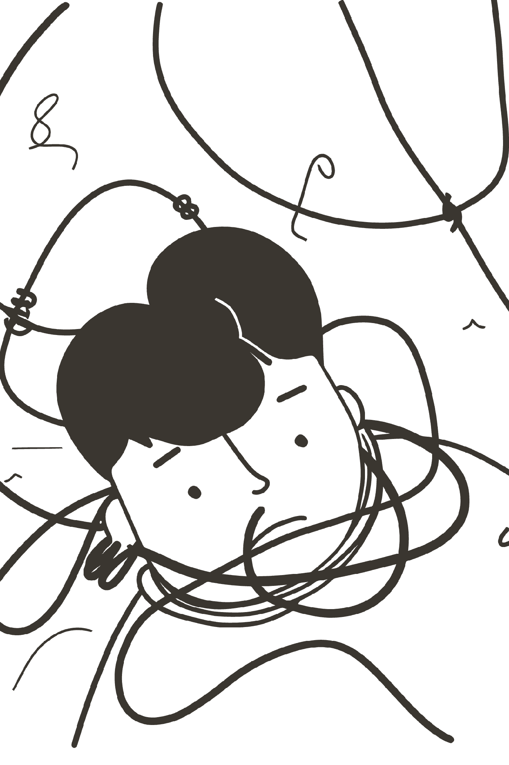
THE CHALLENGE
1,200+ Government Schemes — Yet Millions Still Fall Through the Cracks
India's welfare architecture is vast, but access remains deeply unequal. A fragmented digital landscape, language barriers, and unreliable intermediaries prevent the most vulnerable citizens from claiming their rights. The result is a crisis of exclusion — not of intent, but of design.

Slide 2

THE PROBLEM
Three Barriers Standing Between Citizens and Their Rights
The Burden of Complexity
The Digital Divide
The Trust Gap
Over 1,200 government schemes exist across central, state, and local levels — yet they are scattered across disconnected portals with no unified entry point. Citizens must navigate dozens of websites, each with its own format, requirements, and update cycles, making discovery nearly impossible without expert guidance.
Bureaucratic jargon and English-first interfaces create insurmountable barriers for rural workers, elderly citizens, and first-generation students. When eligibility criteria are written in legal language rather than plain speech, entire communities are effectively locked out of benefits they are entitled to.
In the absence of reliable official guidance, citizens turn to unofficial third-party intermediaries who often charge fees, provide outdated information, or submit incorrect applications. This leads to high rejection rates, financial loss, and deepening distrust in government systems.

Slide 3

THE SOLUTION
Sahaaya Setu: An AI-Driven Pathway for Every Citizen
Sahaaya Setu transforms fragmented government data into a clear, personalized, and actionable journey. By collecting just a few key details about a user's profile, the platform's AI engine evaluates eligibility across hundreds of schemes and delivers a ranked, verified shortlist — all within minutes.
User Profile
AI Analysis
Enter age, income, location, category.
Evaluate profile against scheme criteria.
Eligibility Score
Schemes Matched
Assign a match confidence per scheme.
Personalized list with application links.
This end-to-end process replaces days of manual searching with a structured, intelligent workflow — ensuring no eligible citizen is left without a clear path to their entitlements.

Slide 4
AI GUIDANCE & INCLUSIVITY
Clarity, Preparation, and Access — Built Into Every Interaction
AI-Powered Guidance
Trust & Inclusivity by Design
The built-in AI assistant answers questions about documents, eligibility, and application steps in plain, conversational language. It generates a customized document checklist tailored to each user's matched schemes, helping them avoid common errors and delays before they even begin the application process.
Every scheme result links directly to verified official government portals such as myScheme and PM-KISAN — eliminating reliance on unverified intermediaries. The platform is fully accessible in 15+ Indian languages and features an inclusive UI with adjustable text sizes and high-contrast modes, ensuring no community is left behind.
Instant answers in simple language
Personalized document checklists
Step-by-step application navigation
Verified links to official portals
15+ Indian language support
Accessibility features for all abilities

Slide 5
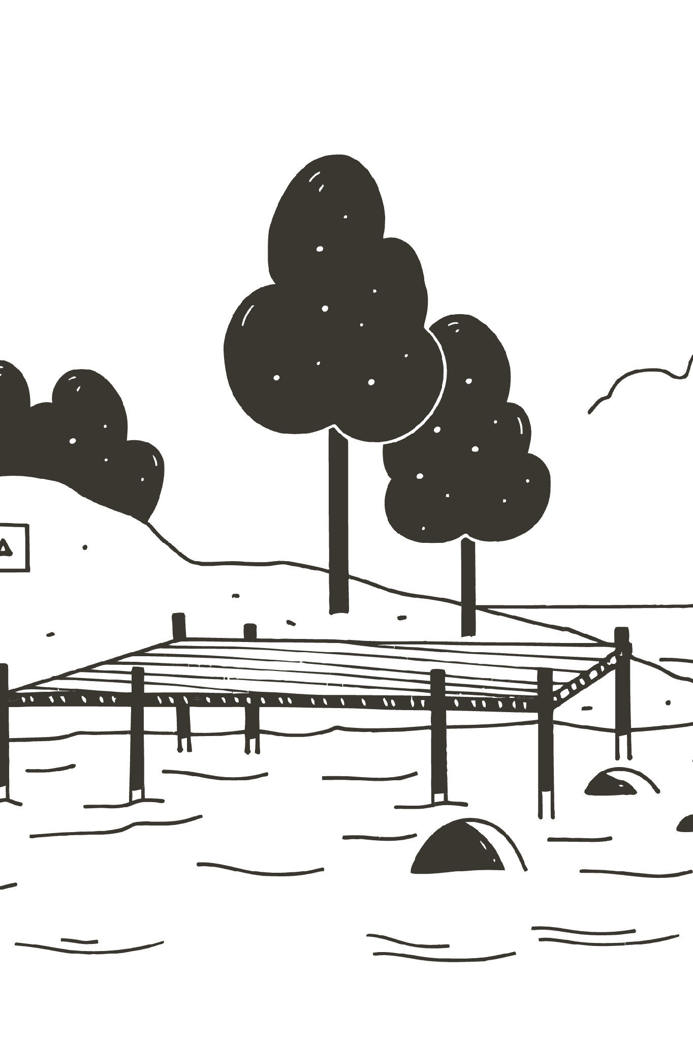
IMPACT & VISION
From 3 Days of Searching to 3 Minutes of Clarity
3 min
1,200+
Time to Results
Schemes Indexed
What once required days of searching across fragmented portals is now accomplished in minutes through AI-guided interaction.
A unified database spanning central, state, and local government welfare programs — all searchable from one entry point.
10+
Languages Supported
Full platform accessibility in 10+ Indian languages, ensuring rural, tribal, and non-English-speaking communities can participate equally.
Sahaaya Setu is more than a tool — it is a bridge. A bridge between a citizen and their rights, between complexity and clarity, and between exclusion and a truly inclusive India where every person can claim the support they deserve.

